Slide 1
Introduction
Find a code base
Perform Static and Dynamic analysis on that.
Static Analysis
  Generate AST
  Metrics Calculation
Dynamic Analysis
  Code coverage
Find a suitable tools to support your analysis
Prepare a report on your work providing necessary screenshots and explanation

Slide 2
Find the Codebase
https://github.com/avinash201199/Projects

Slide 3
Dynamic Analysis and Static Analysis

Slide 4
Dynamic Analysis
Def: Dynamic analysis is the ability to track what is happening during program execution.
The Python settrace() mechanism allows you to track all code lines, all variables, all values, as the program executes
Python sys module provides some of the powerful functions but they are complex to understand. One of which is the sys.settrace() which is used for implementing debuggers, profilers and coverage tools.
On a higher level, sys.settrace() registers the traceback to the Python interpreter. A traceback is basically the information that is returned when an event happens in the code.

Slide 5
Dynamic Analysis
The registered traceback is invoked when one of the following four events occur :
Function is called
Function returns
Execution of a line
Exception is raised

Slide 6
Dynamic Analysis
Syntax: sys.settrace(frame, event, arg.frame)
Parameters:
frame: frame is the current stack frame
event: A string which be either 'call', 'line', 'return', 'exception' or 'opcode'
arg: Depends on the event type
Returns: Reference to the local trace function which then returns reference to itself

Slide 7
Example 1:
import sys
def my_tracer(frame, event, arg = None):
code = frame.f_code
func_name = code.co_name
line_no = frame.f_lineno
print(f"A {event} encountered in \
{func_name}() at line number {line_no} ")
return my_tracer

Slide 8
Example 1:
def fun(a, b):
c=a+b
return c
def check():
return fun(1,2)
sys.settrace(my_tracer)
print(check())
sys.settrace(None)

Slide 9
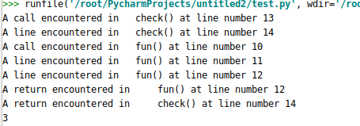
Output of Example 1

Slide 10
Example 2:
import sys
import inspect
def my_tracer(frame, event, arg):
function_code = frame.f_code
function_name = function_code.co_name
lineno = frame.f_lineno
vars = frame.f_locals
source_lines, starting_line_no = inspect.getsourcelines(frame.f_code)
loc = f"{function_name}:{lineno} {source_lines[lineno -
starting_line_no].rstrip()}"
vars = ", ".join(f"{name} = {vars[name]}" for name in vars)
print(f"{loc:50} ({vars})")
return my_tracer

Slide 11
Dynamic Analysis (Scalene Tool)
The Memory Profiler is a component that helps you identify memory leaks and memory churn that can lead to stutter, freezes, and even app crashes.
Installation: Pip Install Scalene
Github Link: https://github.com/plasma-umass/scalene

Slide 12
Static Analysis
Static analysis refers to the ability to analyze program code without actually executing it.
An Abstract Syntax Tree (AST) is a tree representation of the syntactic structure of source code, where: Nodes represent constructs in the source code (e.g., variables, loops, functions).Branches represent relationships between those constructs (e.g., "a loop contains a condition").

Slide 13
Generate AST
https://dev.to/balapriya/abstract-syntax-tree-ast-explained-in-plain-english-1h38
AST Explorer: https://astexplorer.net/

Slide 14
Example 1:
import ast
code = "one_plus_two = 1+2"
tree = ast.parse(code)
print(ast.dump(tree))

Slide 15
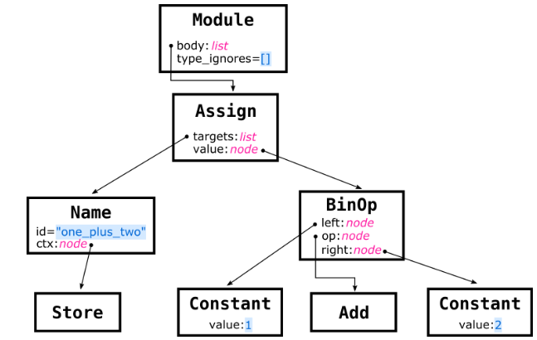

Slide 16
Example 2:
import ast
tree_ast = ast.parse('''
subjects = ['computer science', 'alorithm']
name = 'Ricky'
for sub in subjects:
print('{} learn {}'.format(name, sub))
''')
print(ast.dump(tree_ast))

Slide 17
Sonarqube Static Analysis tool
https://www.sonarsource.com/products/sonarqube/

